Slide 1
Data Publication
EDS213 - Databases & Data Management
Week 10
Renata Curty & Greg Janée
Research Data Services, UCSB Library
rds@library.ucsb.edu

Slide 2
Previously on EDS-213
Data is copyrightable only as compilations under certain conditions.
Data, databases, and software are considered separate entities.
Not all data can be public domain, but if federally funded and no exemption applied, you can request it.
Data produced can be commercialized under data license agreements. Read them carefully!
Databases and code can be subject to copyright, but in academia, open licenses are more commonly considered.
Creative Commons does not imply copyright filling but is an expansion of the "all rights reserved" idea.
Creative Commons licenses should not be used for software/code.
Many repositories operate under CC0 for data, but attribution is still endorsed.

Slide 3
Learning Objectives
Understand the importance of publishing research data
Identify and select appropriate approaches to data publication
Explain the role of persistent identifiers

Slide 4
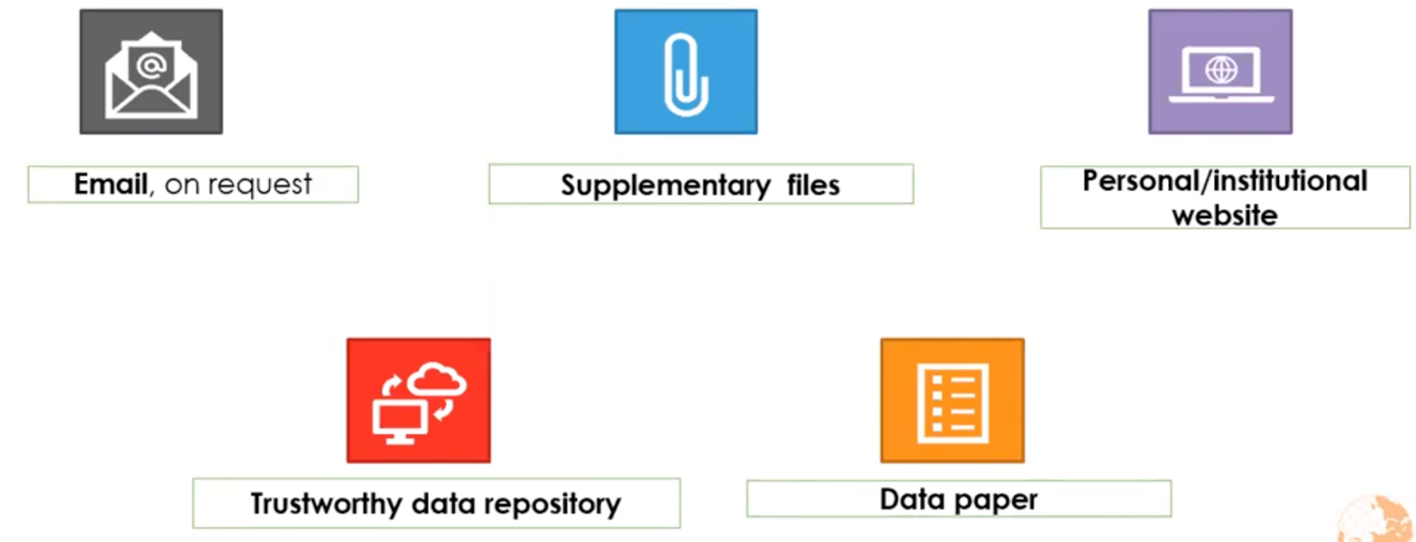

Data Sharing/Publication

Slide 5
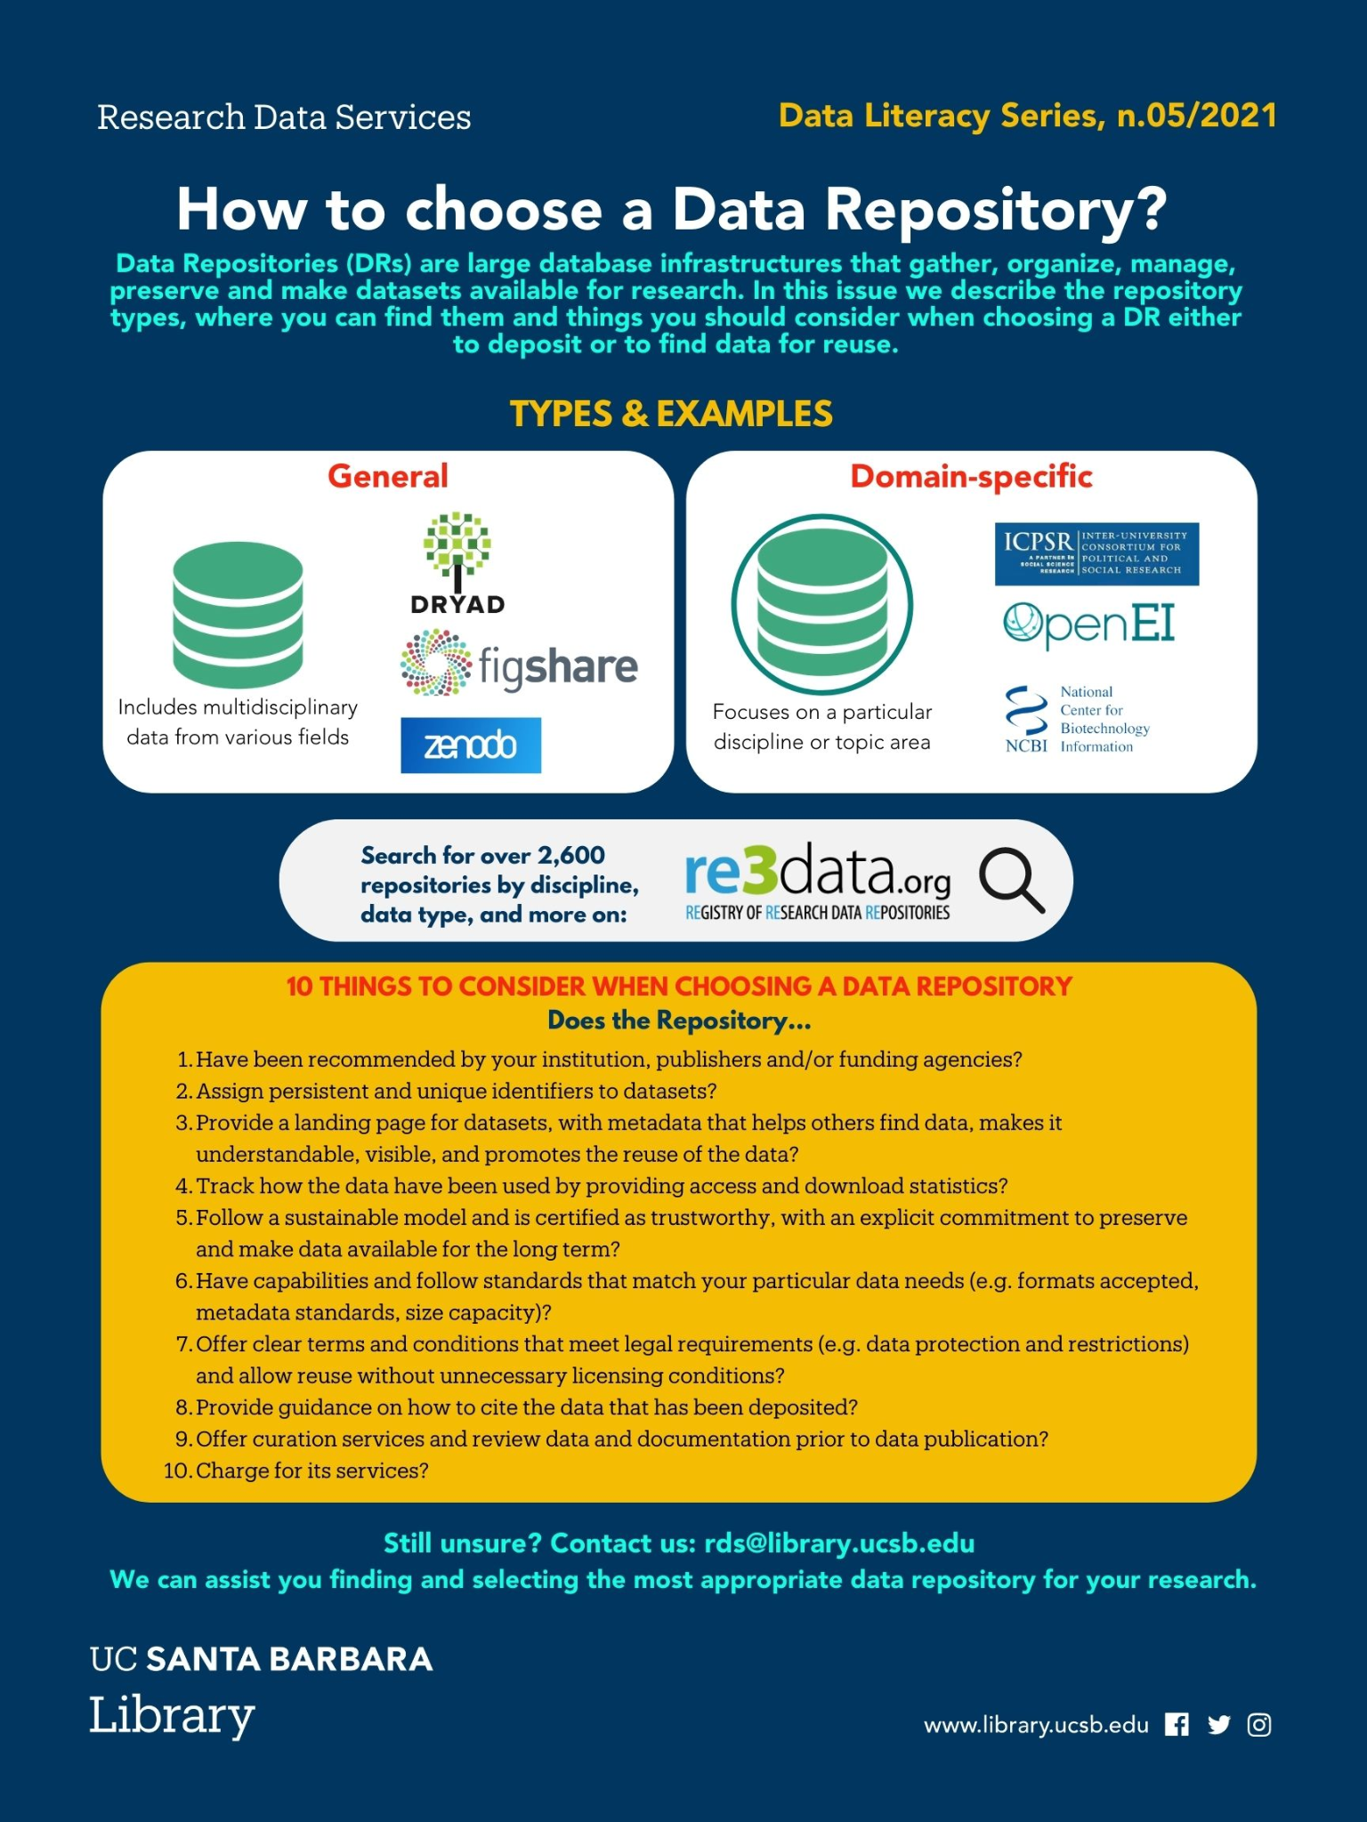
Why a Data Repository?
You can’t lose data that’s in a public data repository
They support understanding, reanalysis and reuse
Data repositories facilitate discovery
Open data demonstrates transparency and rigor
Citations

Slide 6
Give preference to…
A disciplinary repository (re3data.org)
A repository that…
Funders and publishers endorse/recommend
Offers curation services
Assigns DOIs
Provides a formal citation

Slide 7
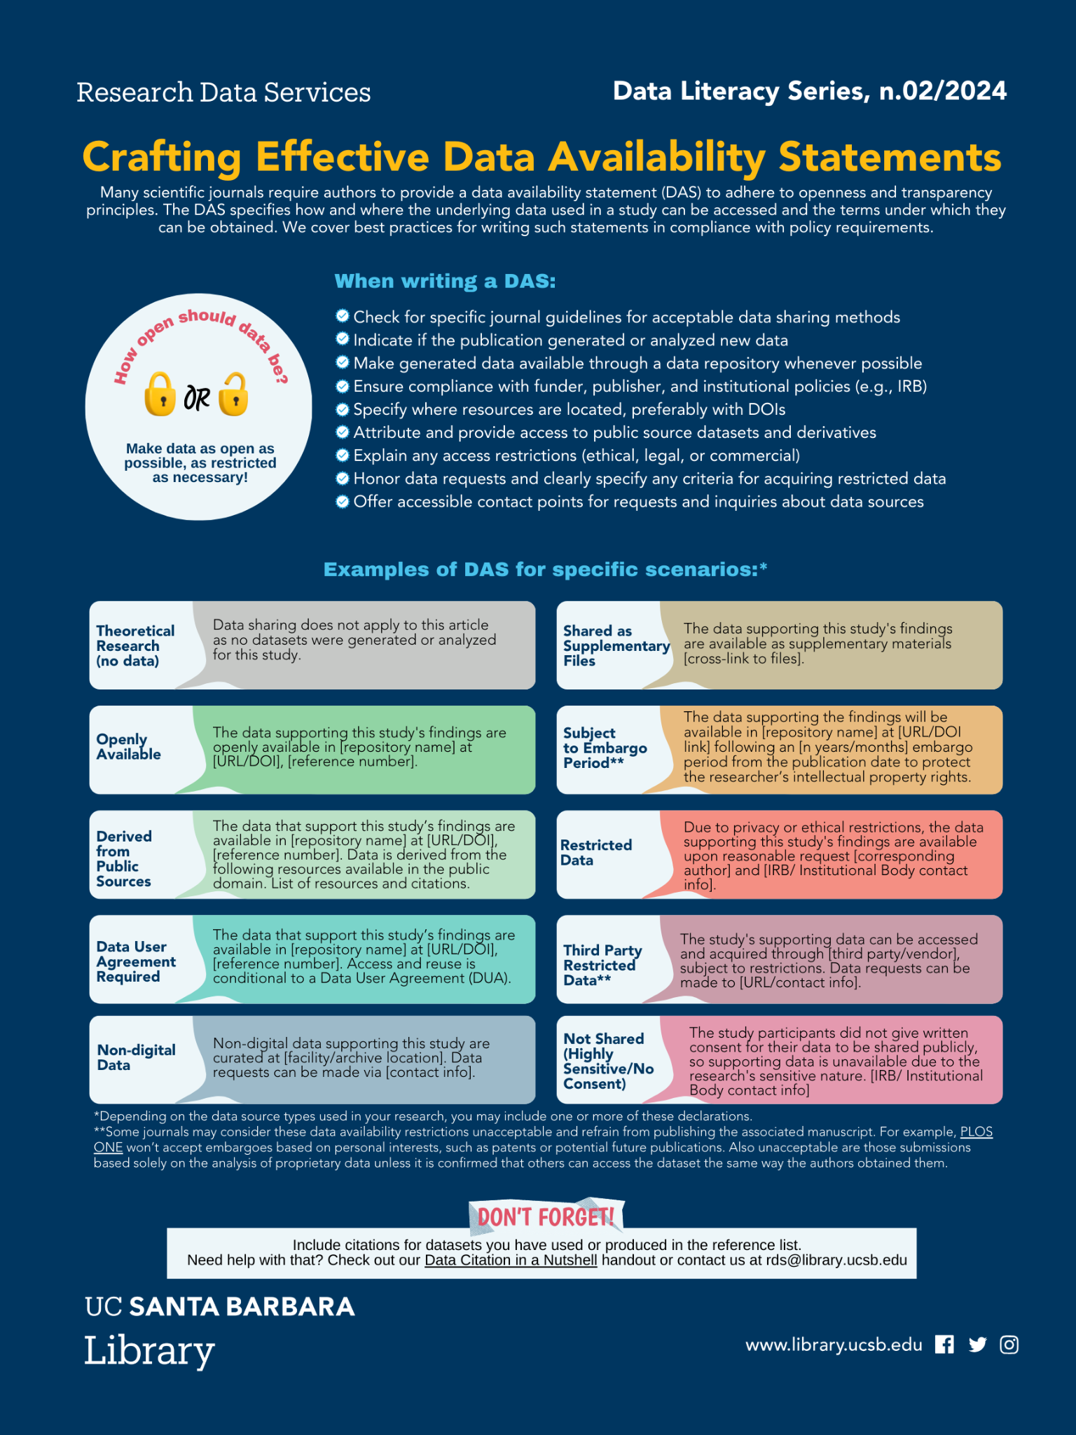
More on Best Practices
Add a data availability statement to related publications and deliverables (even if not required)
Explain any access restrictions (ethical, legal, or commercial)
Honor data requests and clearly specify any criteria for acquiring restricted data
Offer accessible contact points for requests and inquiries about data sources

Slide 8
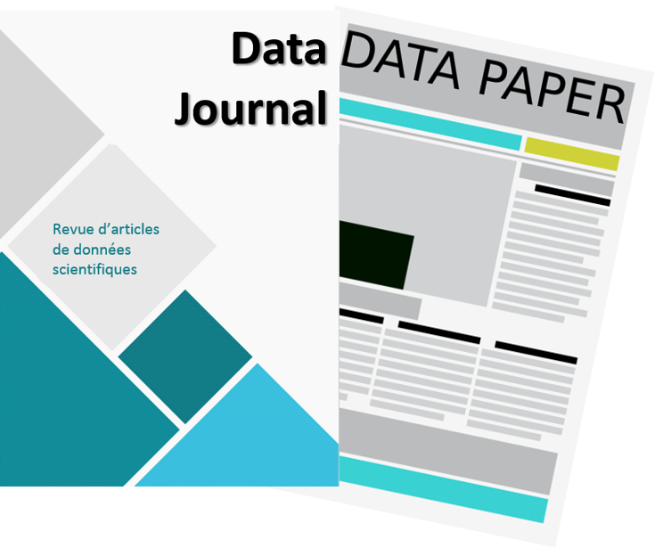
Consider a Data Paper
Data papers can help elevate the visibility of project data promoting the culture of openness and collaboration, while also providing the more traditional incentives for academics.
Not mutually exclusive; the data archive remains relevant
Can be published in dedicated Data Journals or journals that accept this category of submission
List of Relevant Data Journals in Biodiversity: https://www.gbif.org/data-papers
https://www.enago.com/academy/should-you-publish-your-research-data-the-new-trend-of-data-journals

Slide 9
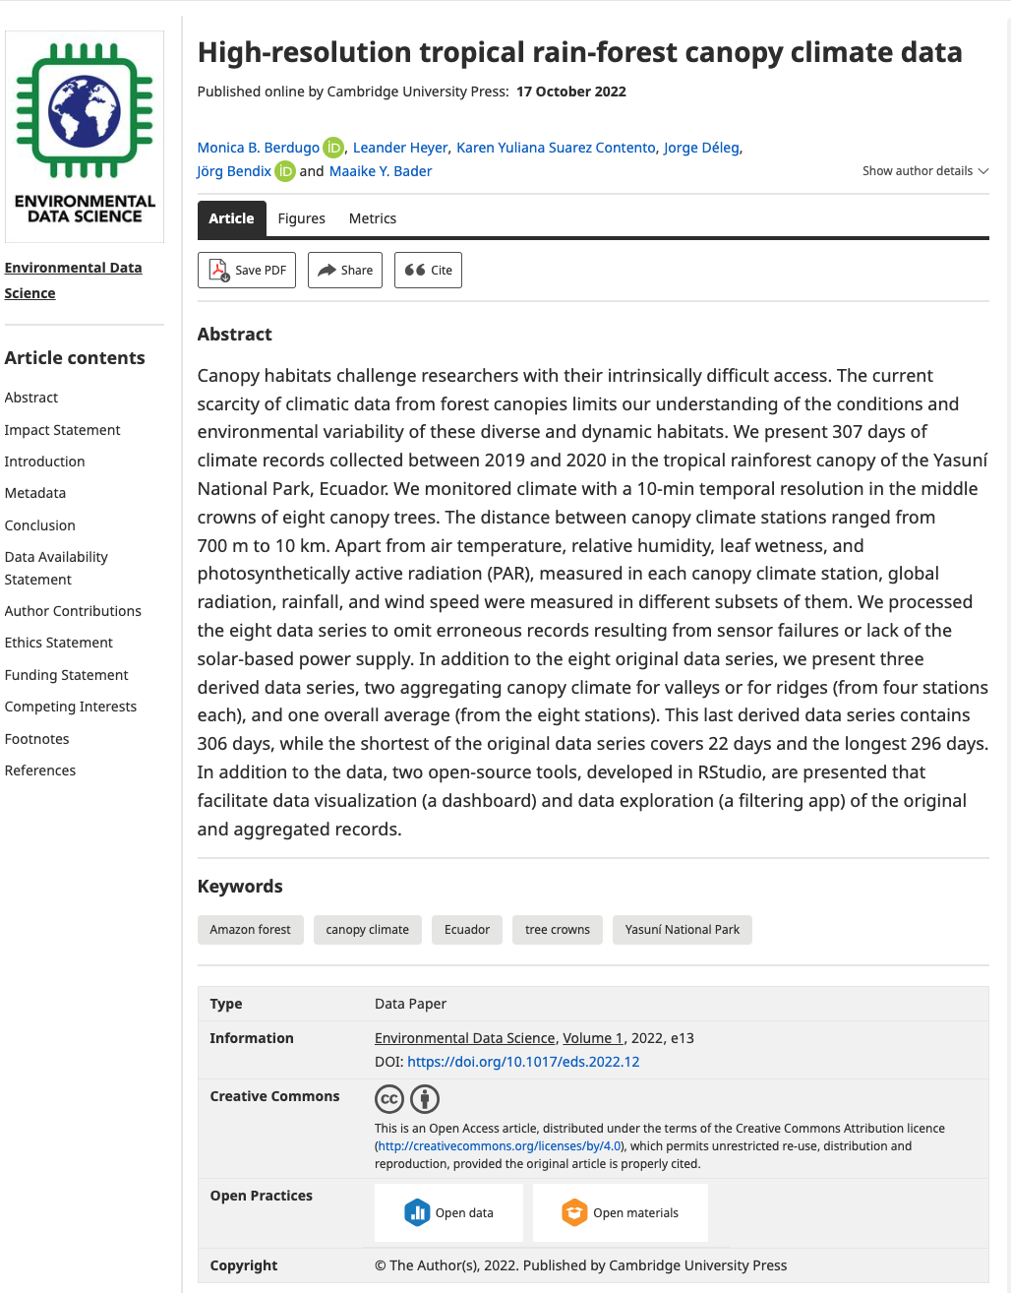
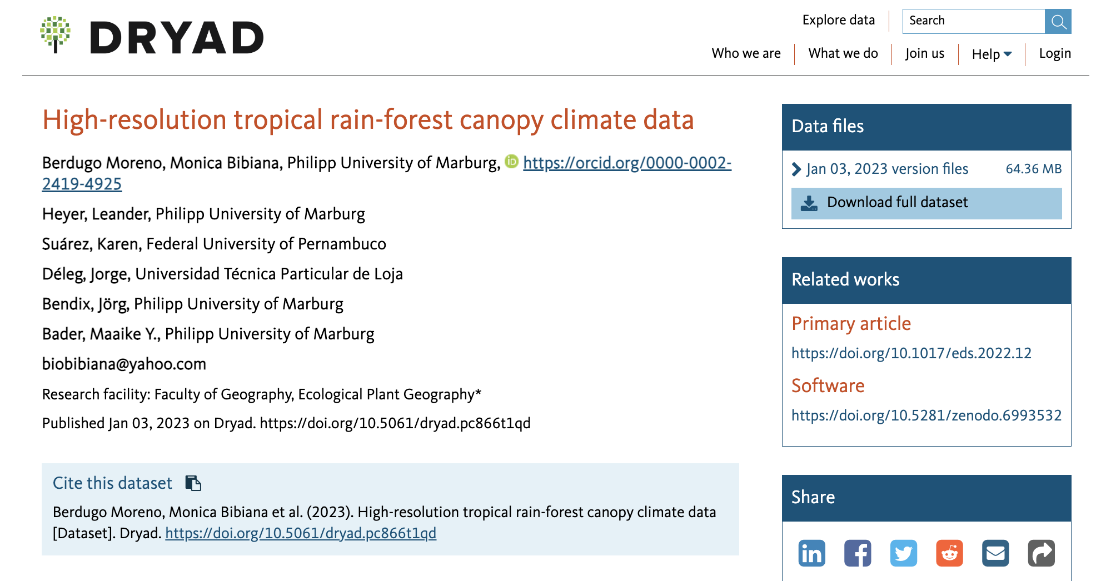
Data Papers
Cross-referenced, using persistent identifiers.
https://doi.org/10.5061/dryad.pc866t1qd
https://doi.org/10.1017/eds.2022.12

Slide 10
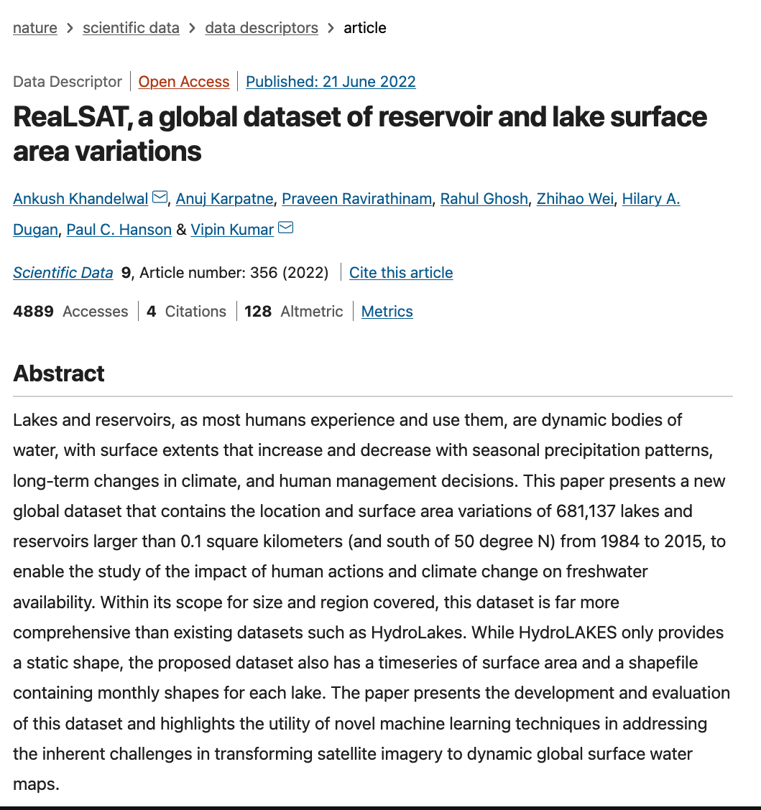
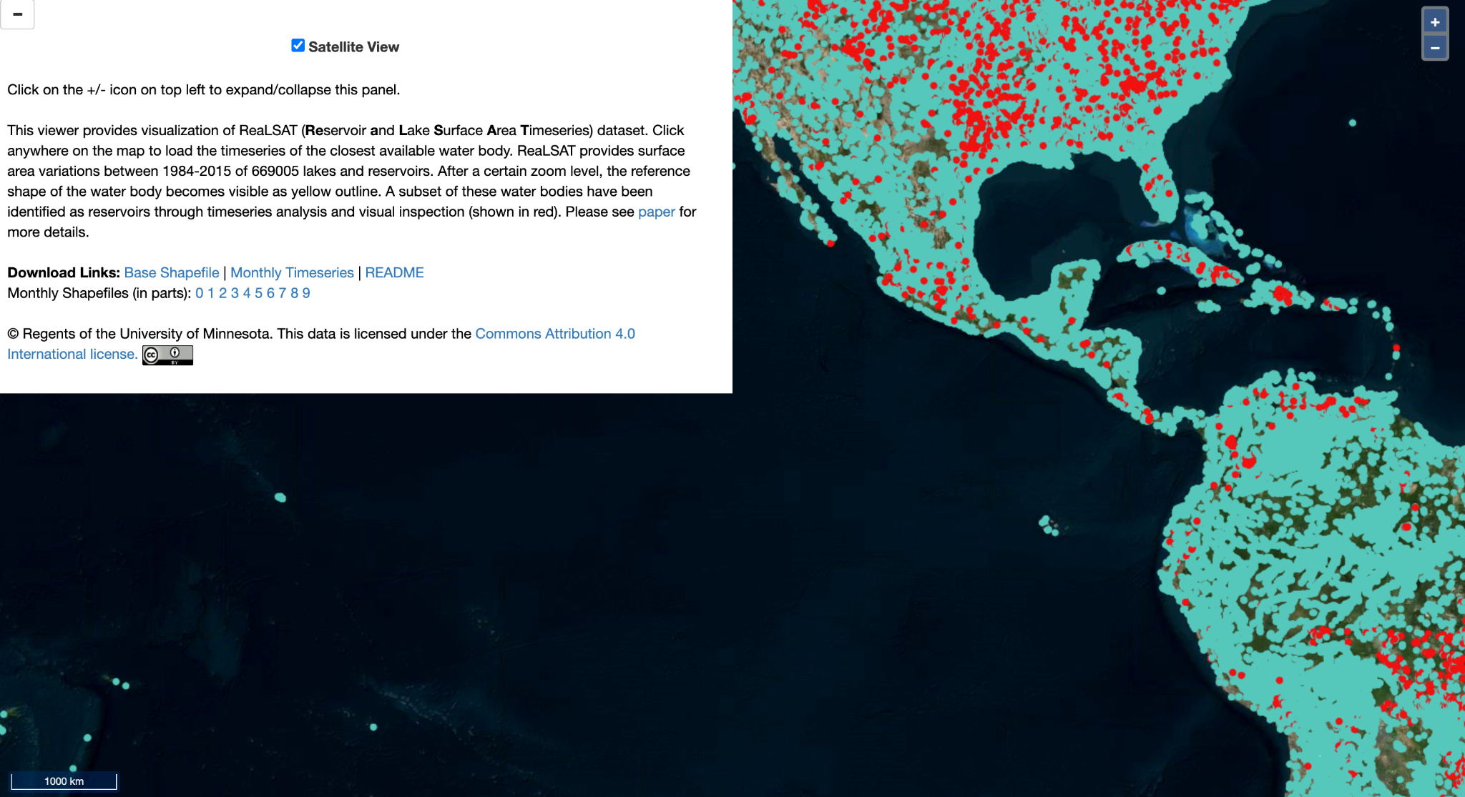
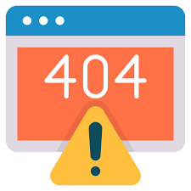
Another example (oh no!)
Data Records
All data records are available for download from Zenodo34 and a zoomable visualization is available at c.
https://doi.org/10.1038/s41597-022-01449-5

Slide 11
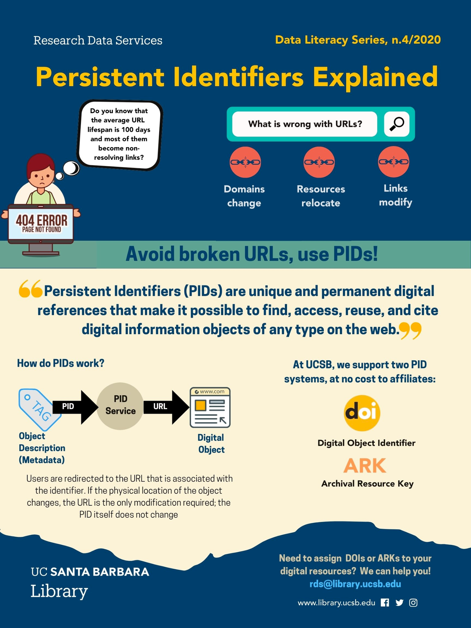
Persistent Identifiers
Most repositories will mint a PId to datasets!
Most journals will mint a PId for papers!
Some repos such as Zenodo and Figshare also create PIds for a variety of other scholarly digital objects (slides, images, code/software)
Released repos on GitHub are assigned a DOI via a Zenodo integration (let’s see how it works!)

Slide 12

Why Publish your Capstone Data?
A safe place To archive
your work
requirements
You will be soon loosing access to your UCSB resources!!!
For your portfolio!
Accountability!
Notes:
So why should you publish your GP data?
A data repository is a safe place to archive your data, independent of your current institution. You will be graduating and thus losing access to your Bren computing resources
It adds to your portfolio you can showcase during job interviews. Data archive get a DOI and thus can be added to your CV under publications
On the stick side, well it is a GP requirements for your graduation

Slide 13
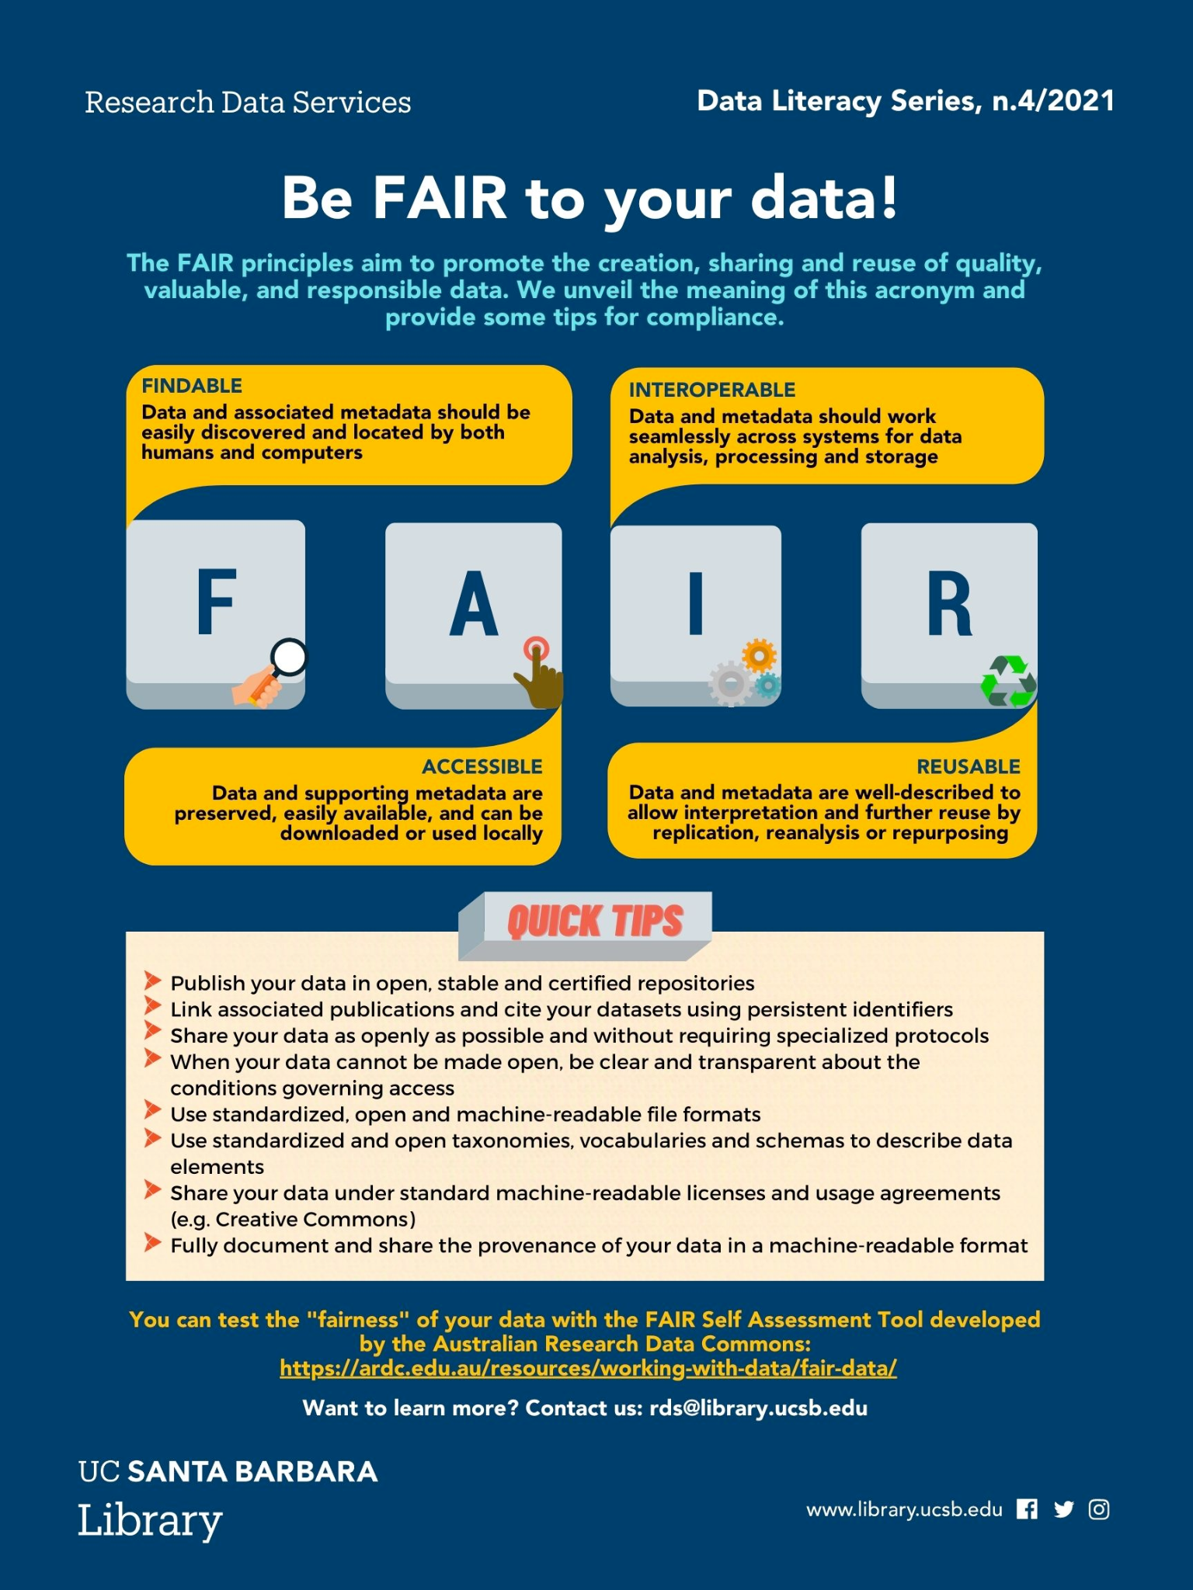
As a Recap…
Not any data!
Well-documented (README + metadata)
Open format
With link to the associated code (if any)
With a explicit license
In a stable repository
With a persistent identifier

Slide 14


LEGO time
This activity was adapted by Halina Do-Linh from the LEGO® Metadata for Reproducibility game pack, which was developed by Mary Donaldson and Matt Mahon

Slide 15
Lessons Learned
What are key elements of good documentation?
A shared & defined vocabulary
Your future self and others will rely on it
Should avoid ambiguities
It requires time and iterations
=> Develop documentation when things are fresh in your mind, make it part of your research workflow!
Notes:
— RENATA starts here —

